Slide 1
Senior Project Presentation
Jimmy Maslen

Slide 2
What did I do for my Senior Project?
Overarching goal:
Program computers to learn simple games
Learning objectives:
Learn Python
Learn about machine learning
Create a cool project
Notes:
What did I do for my project?
Used machine learning to teach computers to play simple games
Things I wanted to get out of this project
Learn Python, which is a language I don’t have a lot of experience in
Learn more about about machine learning and not just apply the algorithms, but understand how they work
Create a project that is demonstrative of my programming experience and knowledge of machine learning
The purpose of my project was not to create the best game playing ai, but to see how I could use and learn about machine learning

Slide 3
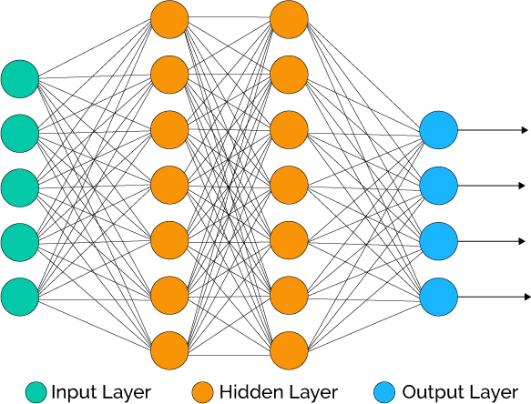
What is machine learning?
Programming computers to learn.
Often done with neural networks.
Takes in a group of inputs, outputs a number of outputs, and can be strategically modified in order to get certain outputs based on the inputs.
Diagram of a Neural Network
Notes:
The field of machine learning involves programming computers to learn as opposed explicitly programming them to do certain tasks.
This is often, but not always, done with a neural network.
A neural network is a structure based off the human brain and can be visualized as a group of connected nodes. (pictured to the right)
The important parts are that it takes in a group of inputs, outputs a number of outputs, and can be strategically modified in order to get certain outputs based on the inputs.
Neural networks played a big role in my project
https://www.xenonstack.com/blog/artificial-neural-network-applications/

Slide 4
NeuroEvolution of Augmenting Topologies (NEAT)
NeuroEvolution (NE):
A process during which neural networks are optimized through simulated evolution.
3
Breed
Breed the networks which had the highest fitness to create a new population of network.
Simulate
Calculate fitness of networks by simulating gameplay.
1
2
Sort
Sort population of networks based on fitness.
Augmenting Topologies (AT):
Network structure can change as evolution occurs.
Notes:
For my project I decided to implement the NeuroEvolution of Augmenting Topologies (NEAT) algorithm
Can be separated into two parts
Start out with a certain population of networks
Calculate fitness of networks by simulating gameplay
Sort population of networks based on fitness
Breed the networks which had the highest fitness to create a new population of network.
Do the procedure all over again until a desired fitness is reached.
Children may not share the same topologies as their parents.
Don’t worry about this if you’re new to neural networks.

Slide 5


Project 1: Dinosaur Game
Dinosaur Game
Game about dinosaur who must avoid obstacles
Fitness calculated by number of obstacles evaded
Dinosaur game
Video
Notes:
Dinosaur Game
Game can be found by trying to load a page in Google Chrome without internet connection
Involves a dinosaur who must jump or duck to avoid cactuses and pterodactyls
Fitness calculated by number of obstacles jumped over
At the beginning dinosaurs are not very good at the game, but they quickly learn to handle the basic obstacles, until eventually they master the game

Slide 6
Project 2: Navigation
The goal of this “game” is survival
Players must avoid obstacles
Used time survived as a measure of fitness
Tried a few different courses
Video
Notes:
This game involves players trying to escape a storm and live as long as possible
Players must avoid obstacles such as lava and/or walls
Used time survived as a measure of fitness
Sequentially made the course more difficult
First course I tried was a map with no obstacles
Last generation of the evolution, and as you can see, the agents are gravitating towards the middle of the map, which is good

Slide 7
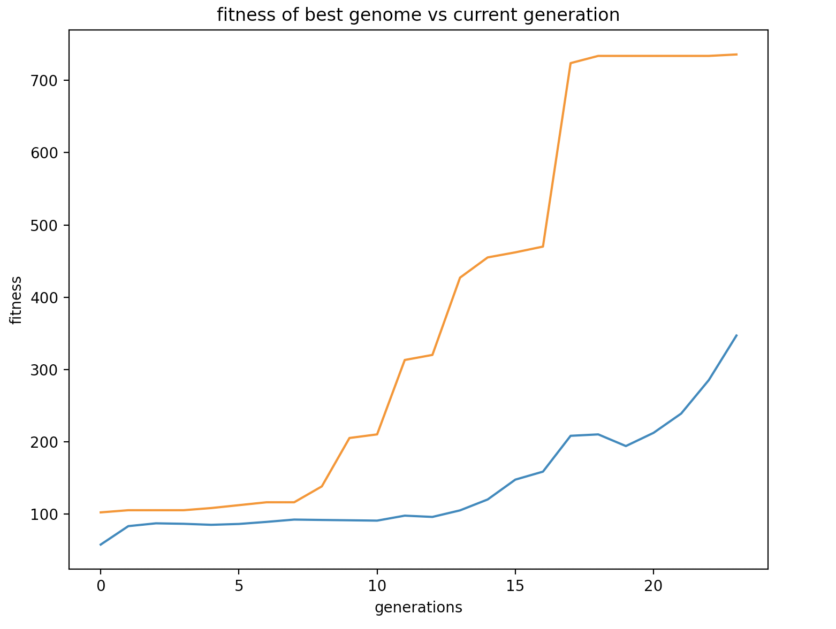
Navigation: Example 1
Video
Orange is best fitness, blue is average
Notes:
Next I moved onto a slightly more complicated version of the game in which agents would need to avoid lava
As you can see, in the first generation, no one does very well
As we move onto later generations, the agents start to learn and get better
Eventually some make it to the middle of the map, the optimal location for survival
And then many make it to the middle of the map

Slide 8
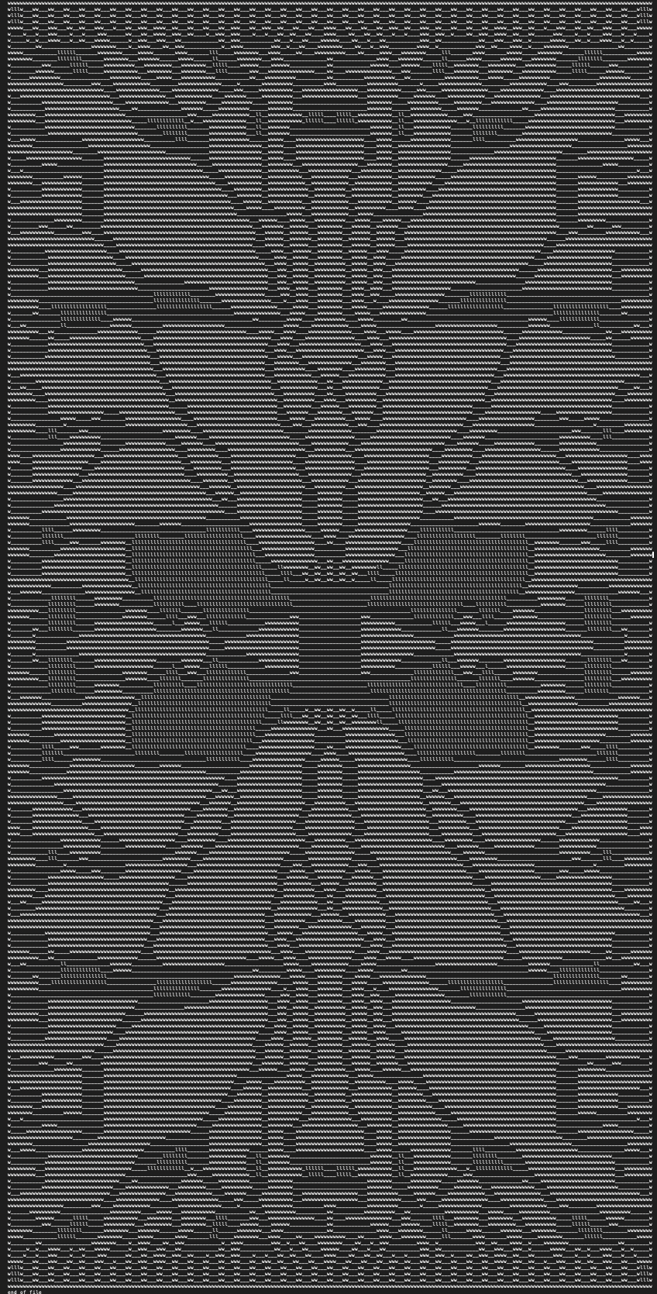
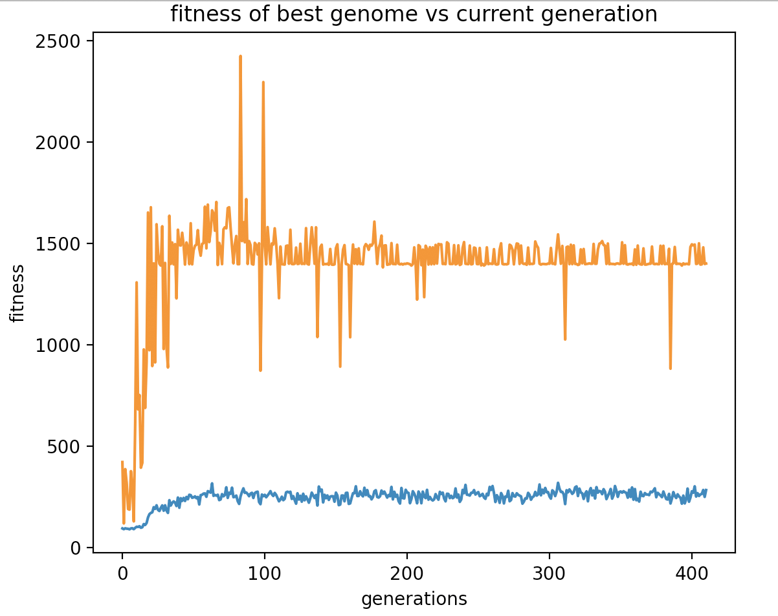
Navigation: Example 2
Map which the players interact with
Orange is best fitness, blue is average
Notes:
Lastly, I worked on having learning occur on a giant map with multiple obstacles and players spawning at random locations (see map)
Unfortunately, I don’t have a video of the results, but I do have this graph which shows how the agents did
As you can see, there is a strange plateau in which progress stagnates for hundreds of generations, which I unfortunately never figured out, but it does actually do survive for a long time, which is impressive given that players are spawning at one of 160 randomly assigned spawn locations, suggesting that robust learning occurred.

Slide 9
Questions

